Slide 1

Zero Trust Architecture
in AWS

Slide 2
CONTENTS
Project Overview
Micro-Segmentation (VPC & Subnets)
Monitoring (CloudTrail & GuardDuty)
Threat Modeling (DREAD)
IAM & Role-based Access Control
Least Privilege & Continuous Authentication
Access Policies
Conclusion
1
2
3
4
5
6
7
8

Slide 3
Ⅰ. Project Overview
The design and implementation of a Zero Trust Architecture (ZTA) using Amazon Web Services (AWS).
Zero Trust: no user or system is inherently trustworthy—every request must be explicitly verified, regardless of its source.
Objectives and Design Principles
Explicit identity-based access control
Least privilege permissions by default
Segmentation of internal resources to reduce attack surface
Continuous monitoring and logging for visibility
Formal threat modeling to evaluate and mitigate risks
Role-Based Access Control
Architect (Root), CodeOwner, Documenter and Tester
Implementation Highlights
IAM Policies: Each role had custom-defined JSON policies ensuring only essential permissions.
VPC and Subnets: Resources were segmented between private and public subnets.
S3 Access Control: The S3 bucket was configured with strict access policies and verified through role-based testing.
Monitoring Tools: CloudTrail and GuardDuty were enabled to track all system events and detect suspicious behaviors.
Threat Modeling: Security threats were formally analyzed using the DREAD framework.

Slide 4
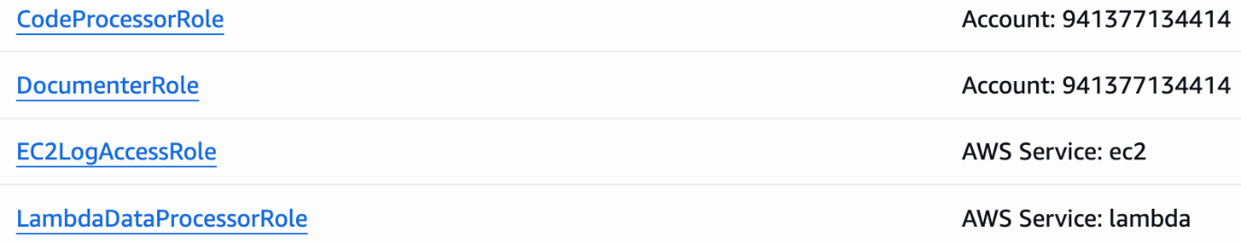
Ⅱ. IAM & Role-based Access Control(1/2)
Role Definition and Assignment
Architect (Root): Full administrative control, responsible for overall architecture and setup
CodeOwner: Has permission to develop and deploy code within the environment
Documenter: Has access to logs for monitoring purposes.
TesterWithNoAccessPrivilege: User for validation tests, no access to critical components
Figure 2.1: Defined IAM Roles in AWS Console
Securing the Confidential S3 Bucket
A secure S3 bucket named confidential-bucket-eric20250713, which included a designated folder for sensitive content.
The Architect and CodeOwner roles were granted access to the folder using fine-grained bucket policy conditions. All other users, including Documenter and TesterWithNoAccess, were explicitly denied access at the policy or resource level.
Uploading a sample text file inside the folder and simulated different user access attempts to validate access controls.

Slide 5
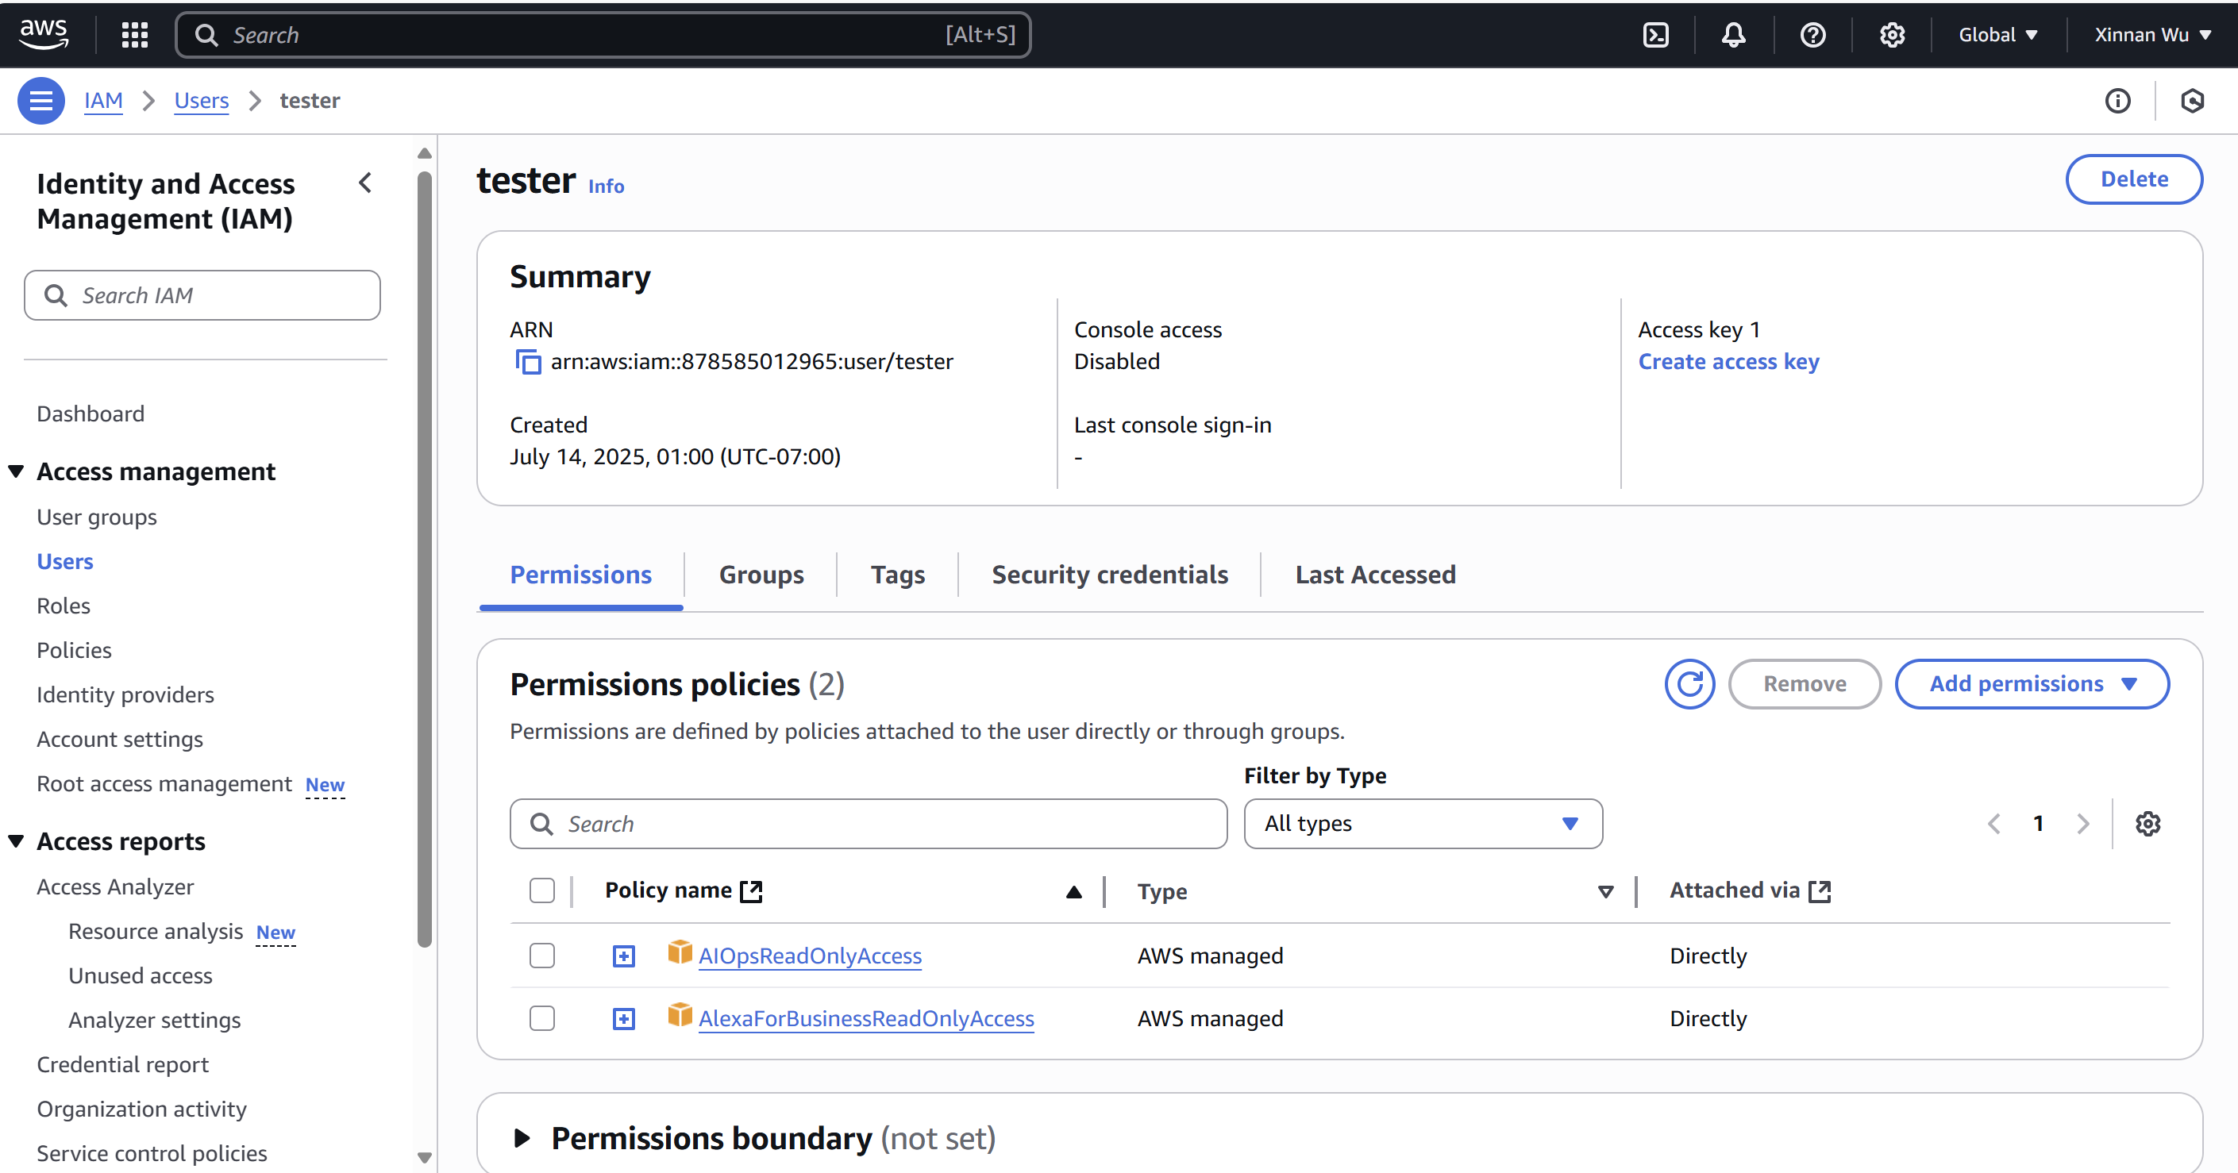
Ⅱ. IAM & Role-based Access Control(2/2)
Validation and Results
When CodeOwner or Architect attempted to access the file (via console or Lambda code), access was successfully granted. And when Documenter or Tester attempted to access the same file, they received “Access Denied” errors.
This validated that the IAM role bindings and S3 bucket policies were functioning correctly, with no implicit trust granted to any user.
Figure 2.3: Permissions Attached to Tester User

Slide 6
Ⅲ. Micro-Segmentation (VPC & Subnets)
AWS (Amazon Web Services)
VPC (Virtual Private Cloud)
PrivateSubnet1
PublicSubnet1
Work zone including codes, database, API etc., but with no direct internet access
Internet-facing zone
1
3
3
Lambda
Lambda SG
5
NAT Gateway
4
External Services
6
Auto-running AWS function
Executes code on demand
Connects private subnet to the internet
External services see only the NAT
AWS Services
Internet
Firewall rules for Lambda
×
×

Slide 7
Ⅳ. Least Privilege & Continuous Authentication (1/4)
The roles include Architect (Root), CodeOwner, Documenter, TesterWithNoAccessPrivilege.
Architect
CodeOwner
Documenter
TesterWithNoAccessPrivilege
all the privileges.
can modify and run the code.
can only read the log.
no privileges to access both code and log.

Slide 8
Ⅳ. Least Privilege & Continuous Authentication (2/4)
Bell-LaPadula
No Read up
No Write down
Least Privilege
Dynamic
Permission based on task
Biba
No Read down
No Write up

Slide 9
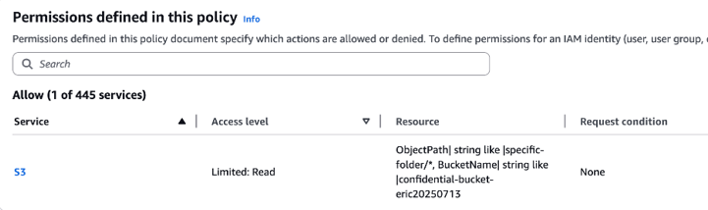
Ⅳ. Least Privilege & Continuous Authentication (3/4)
Explanation
Code
{
"Version": "2012-10-17",
"Statement": [
{
"Effect": "Allow",
"Action": "s3:GetObject",
"Resource": "arn:aws:s3:::confidential-bucket-eric20250713/specific-folder/*"
}
]
}
You do not always have the trust.
Each action you make requires authentication.

Slide 10
Ⅳ. Least Privilege & Continuous Authentication (4/4)
Continuous Authentication
Role-Based Access Control

Slide 11
Ⅴ. Monitoring (CloudTrail & GuardDuty) (1/3)
AWS (Amazon Web Services)
CloudTrail logs API calls across all AWS services (e.g., Lambda, IAM)
GuardDuty analyzes traffic patterns for threat detection
Both services monitor events within the full VPC, not tied to a specific subnet
VPC (Virtual Private Cloud)
CloudTrail
GuardDuty
PrivateSubnet1
PublicSubnet1
External Services
AWS Services
Internet
Lambda
Lambda SG
NAT Gateway

Slide 12
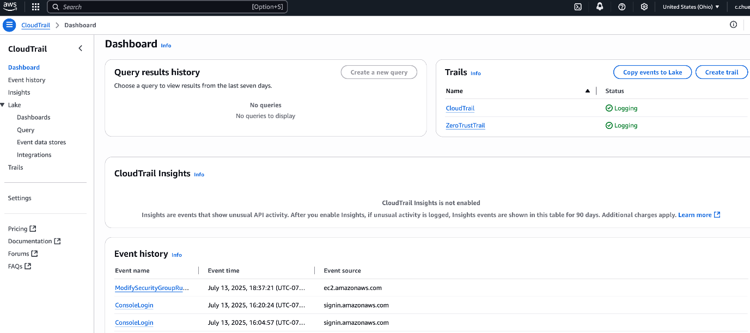
Ⅴ. Monitoring (CloudTrail & GuardDuty) (2/3)
CloudTrail has been actived. It traced logins, Lambda log, and any other changes (role changes, code modifications and process, etc.)

Slide 13
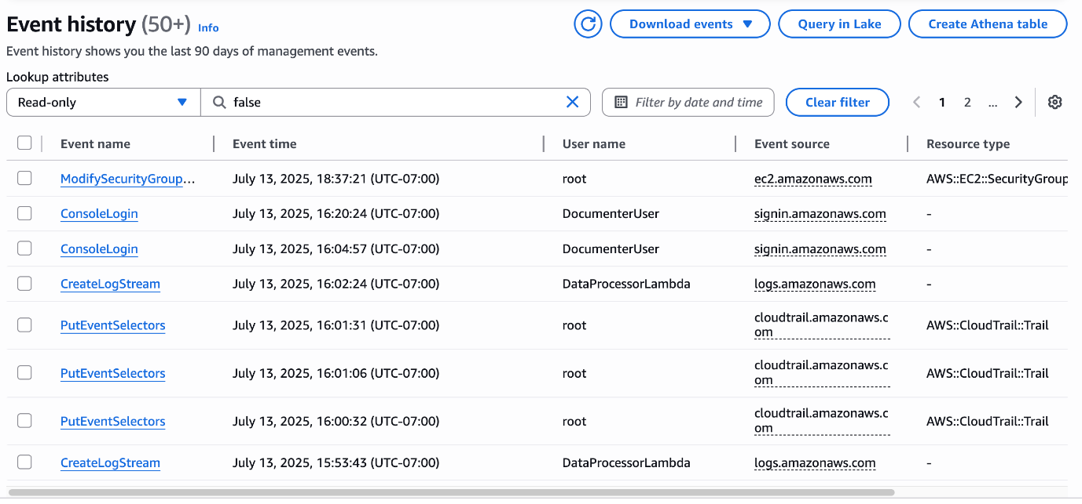
Ⅴ. Monitoring (CloudTrail & GuardDuty) (3/3)

Slide 14
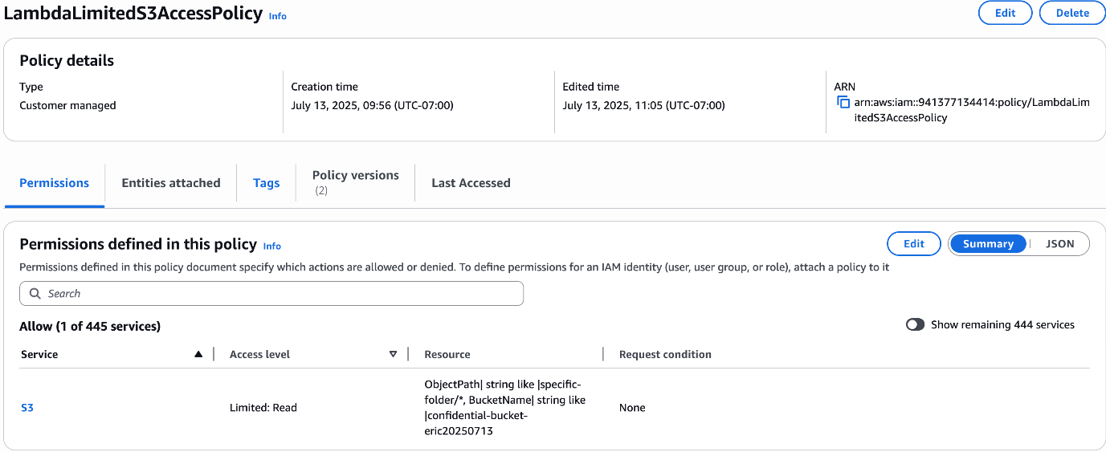
Ⅵ. Access Policies - LambdaLimitedS3AccessPolicy (1/4)
Details
Code
{
"Version": "2012-10-17",
"Statement": [
{
"Effect": "Allow",
"Action": "s3:GetObject",
"Resource": "arn:aws:s3:::confidential-bucket-eric20250713/specific-folder/*"
}
]
}

Slide 15
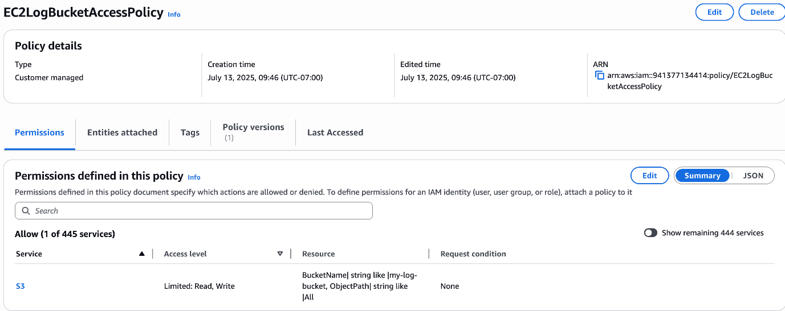
Ⅵ. Access Policies - EC2LogBucketAccessPolicy (2/4)
Details
Code
{
"Version": "2012-10-17",
"Statement": [
{
"Effect": "Allow",
"Action": [
"s3:GetObject",
"s3:PutObject"
],
"Resource": "arn:aws:s3:::my-log-bucket/*"
}
]
}

Slide 16
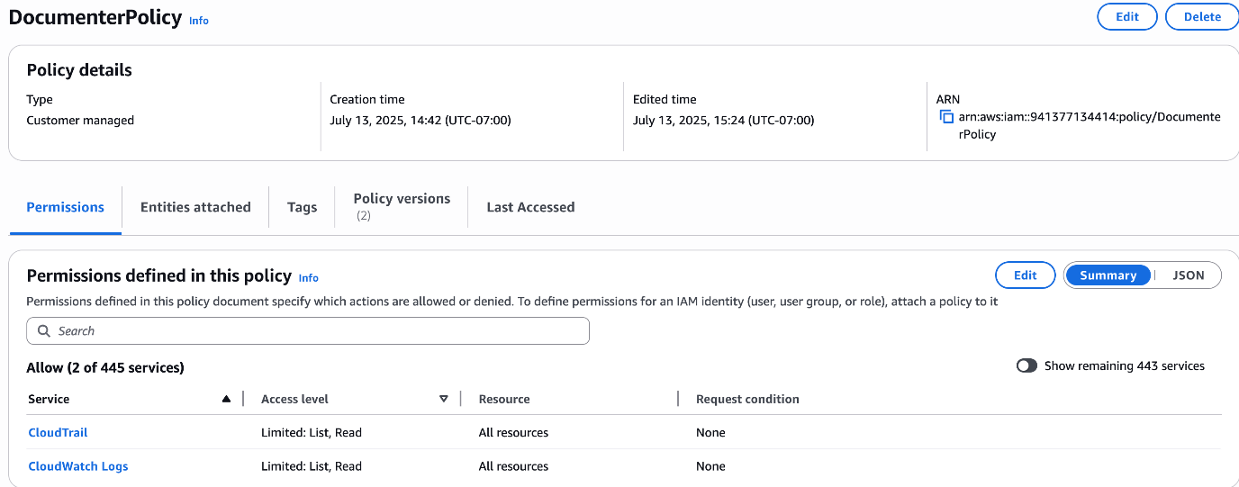
Ⅵ. Access Policies - DocumenterPolicy (3/4)
Details
Code
{
"Version": "2012-10-17",
"Statement": [
{
"Effect": "Allow",
"Action": [
"logs:DescribeLogGroups", "logs:DescribeLogStreams", "logs:GetLogEvents", "cloudtrail:LookupEvents", "cloudtrail:DescribeTrails", "cloudtrail:GetTrailStatus", "cloudtrail:ListEventDataStores"
],
"Resource": "*"
}
]
}

Slide 17
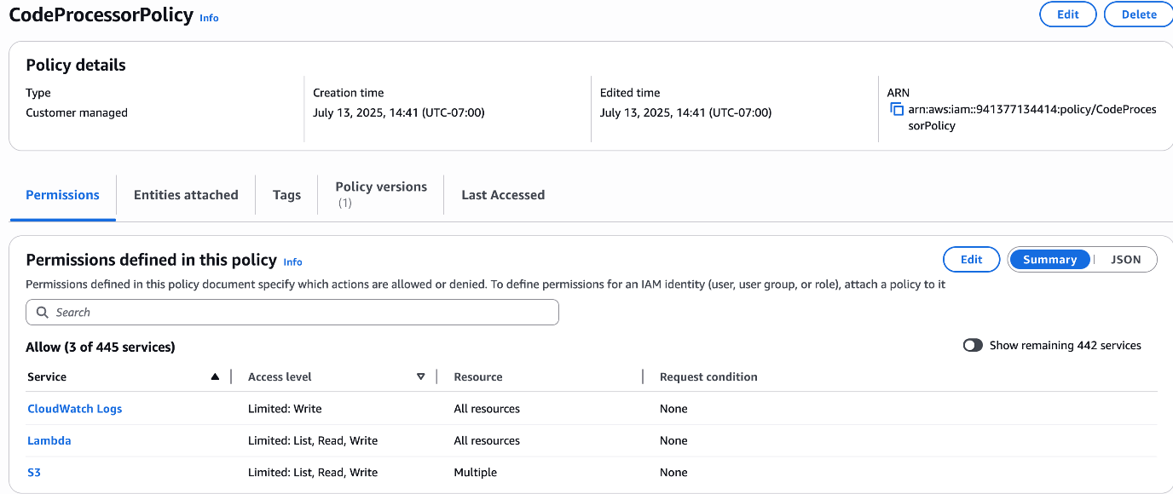
Ⅵ. Access Policies – CodeProcessorPolicy (4/4)
Details
Code
{
"Version": "2012-10-17",
"Statement": [
{
"Effect": "Allow",
"Action": [
"lambda:UpdateFunctionCode",
"lambda:UpdateFunctionConfiguration",
"lambda:InvokeFunction",
"lambda:GetFunction",
"lambda:ListFunctions"
],
"Resource": "*"
},
{
"Effect": "Allow",
"Action": [
"s3:GetObject",
"s3:PutObject",
"s3:ListBucket"
],
"Resource": [
"arn:aws:s3:::confidential-bucket-eric20250713",
"arn:aws:s3:::confidential-bucket-eric20250713/*"
]
},
{
"Effect": "Allow",
"Action": [
"logs:CreateLogGroup",
"logs:CreateLogStream",
"logs:PutLogEvents"
],
"Resource": "*"
}
]
}

Slide 18
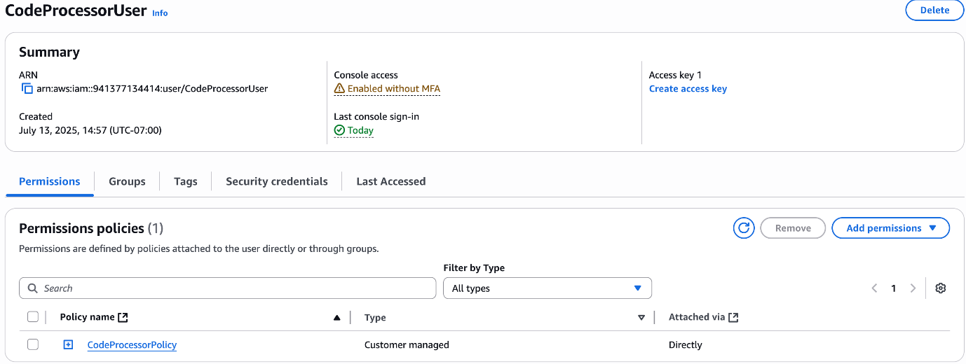
Ⅵ. User/Role Setup (1/3)
CodeUser

Slide 19
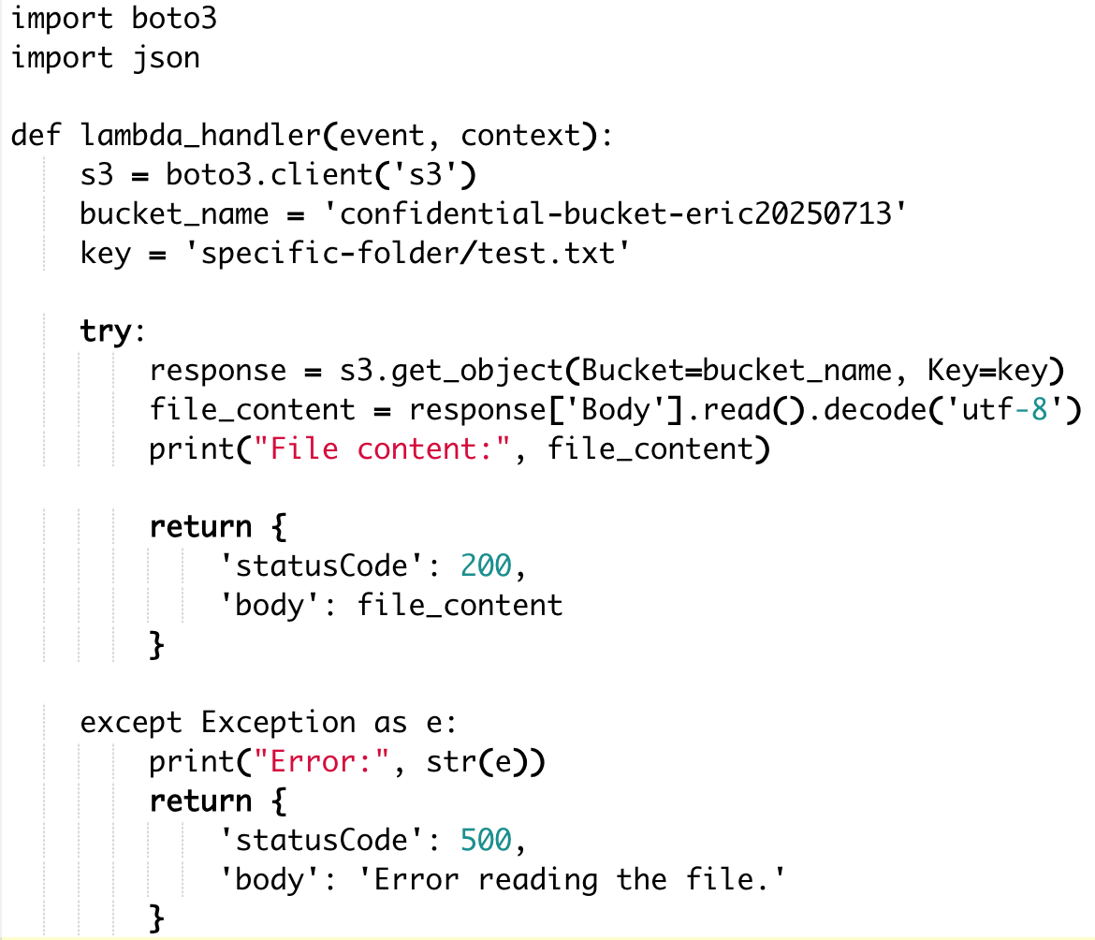
Ⅵ. User/Role Setup (1/3)
CodeUser run Lambda
Securely access a confidential text file stored in a restricted S3 bucket.
boto3 library connect to AWS S3
Reads a specific file from the bucket path confidential-bucket-eric20250713/specific-folder/test.txt
Returns the file content as the output

Slide 20
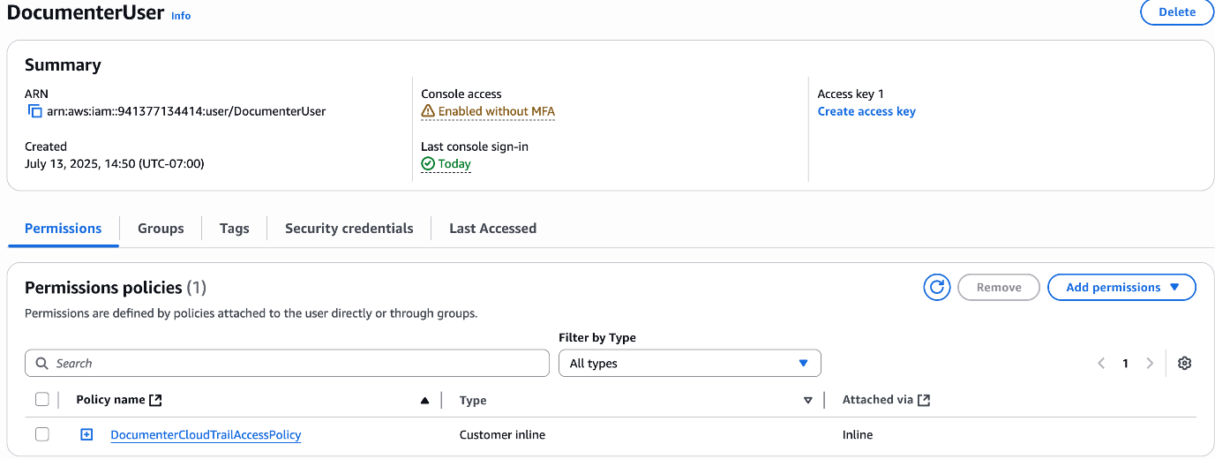
Ⅵ. User/Role Setup (2/3)
Documenter

Slide 21
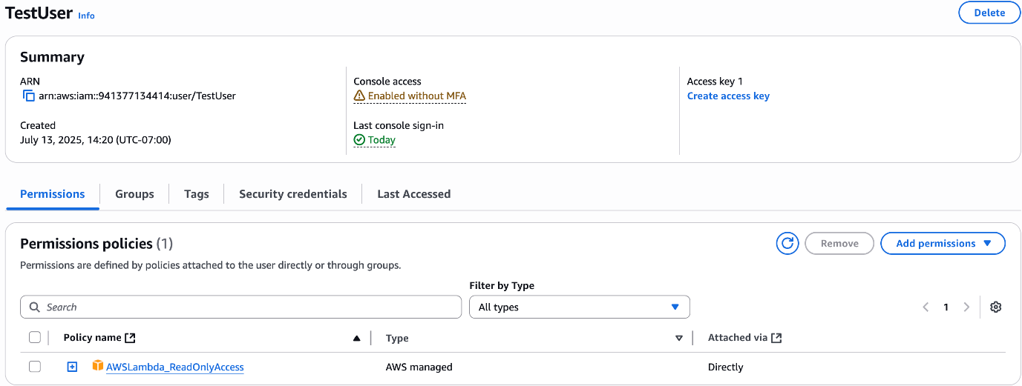
Ⅵ. User/Role Setup (3/3)
Tester

Slide 22
Ⅶ. Threat Modeling (DREAD) (1/2)
In this report, we conduct a formal threat modeling session using the DREAD model to evaluate potential security risks in our AWS-based Zero Trust Architecture. This architecture includes multiple components such as IAM, S3, EC2, VPC segmentation, and monitoring services (CloudTrail, GuardDuty). Our goal is to identify, prioritize, and mitigate key threats to ensure strong security and adherence to Zero Trust principles.
DREAD Factor | Description
D – Damage | How severe the damage would be if the vulnerability were exploited.
R – Reproducibility | How easy it is to reproduce the attack.
E – Exploitability | How easy it is to launch the attack.
A – Affected Users | How many users would be impacted.
D – Discoverability | How easy it is to discover the vulnerability.

Slide 23
Ⅶ. Threat Modeling (DREAD) (2/2)
Scoring is from 1 (low risk) to 10 (high risk) per category. The average score reflects the severity of the threat.
# | Threat Scenario | D | R | E | A | D | Avg. | Description and Mitigation
1 | Public S3 Bucket Exposure | 9 | 10 | 9 | 10 | 9 | 9.4 | Misconfigured S3 permissions can leak sensitive data. Mitigation: Use bucket policies to restrict access, enable logging.
2 | IAM User Credential Compromise | 8 | 7 | 8 | 8 | 6 | 7.4 | Stolen credentials could allow privilege escalation. Mitigation: Enforce MFA, least privilege IAM policies.
3 | EC2 Port Scanning and Brute-force via SSH | 6 | 6 | 7 | 5 | 7 | 6.2 | Attackers may attempt unauthorized access via open SSH port. Mitigation: Restrict SSH to specific IPs in security groups, use key-based auth.
4 | Privilege Escalation via Misconfigured IAM | 7 | 6 | 7 | 6 | 5 | 6.2 | Users with excessive permissions may gain admin access. Mitigation: Apply least privilege principle, conduct IAM access reviews.
5 | Denial of Service (DoS) Attack on Web App | 8 | 5 | 6 | 7 | 6 | 6.4 | Excessive traffic may make the system unavailable. Mitigation: Enable AWS WAF and rate-limiting.
6 | CloudTrail Logs Disabled by Insider | 9 | 6 | 5 | 7 | 7 | 6.8 | Disabling audit logs hides malicious actions. Mitigation: Use service control policies (SCP), monitor trail status.

Slide 24
Ⅷ. Conclusion
Highest Risk Identified: Public S3 bucket exposure – due to both high damage and ease of exploitation. Through the DREAD-based threat modeling, we have identified the most critical vulnerabilities in our AWS Zero Trust Architecture and proposed mitigation strategies. This assessment supports a proactive security posture by highlighting weaknesses before exploitation occurs. All findings will be integrated into our final system design and security documentation.

Slide 25
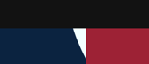
Thank you.

